Slide 1

IoT Gateway using Raspberry Pi
Batch Details
S BHARATH – 1NT18EC134
SHAIK ABDUL ALEEM – 1NT18EC141
Project Supervisor
Prof. Sitaram Yaji
Professor Dept. of Electronics and Communication Engineering
Nitte Meenakshi Institute of Technology Yelahanka, Bangalore-560064

Slide 2
Presentation Outline
Introduction
Objectives
Basic Architecture
Design approach
Specifications of Hardware and Software Tools
Experimental Results
Conclusion

Slide 3
Introduction
What is an IoT Gateway?
An internet of things (IoT) gateway is a network device that serves as the connection point between the cloud and IoT nodes (with sensors and actuators) . Sensors may be connected directly to gateway also
All data moving between IoT nodes and the cloud passes through an IoT gateway, which generally is an embedded system.
An IoT gateway can be intelligent also (edge computing).

Slide 4
Introduction
What does an IoT gateway do?
An IoT gateway acts as a network device, routing data between IoT nodes and the cloud.
Early on, most gateway devices only sent traffic in one direction: from the IoT nodes to the cloud.
Now, it's common for a gateway device to handle both inbound and outbound traffic.
Outbound traffic streams are used for sending IoT data to the cloud, while inbound traffic is used for device management tasks, such as updating device firmware and instructions for actuation.

Slide 5
Project Objectives
The following are the proposed objectives of the mini project
To implement an IoT solution using cloud
To use Raspberry Pi as Gateway
To show control and actuation

Slide 6
IOT Solution using Cloud
Basic Architecture
Android App
T
H
I
N
G
S
Sensor data
IOT Gateway
IOT Application
Network
Control/ actuation
Edge
Cloud / cloud data centre
IoT Application – Temperature Monitoring and Control
(automatic, manual)

Slide 7
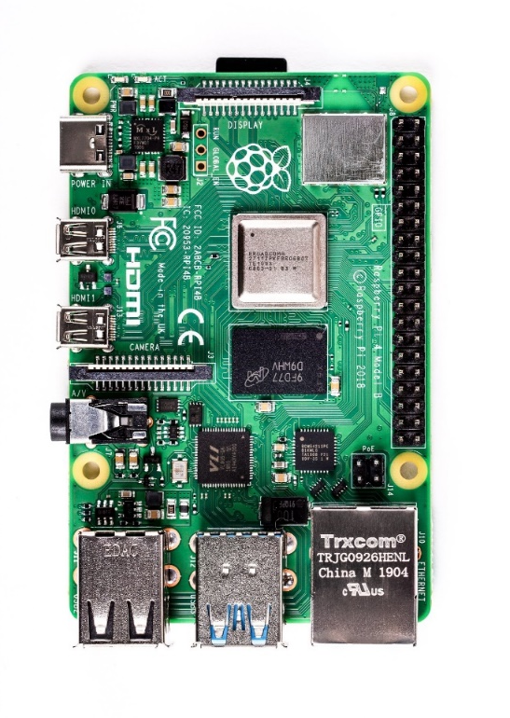
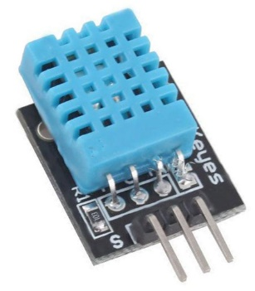

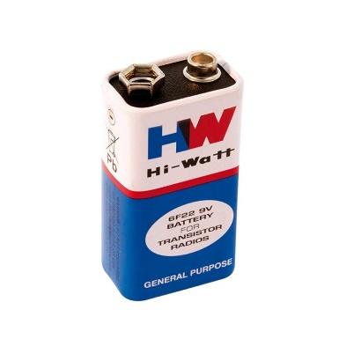
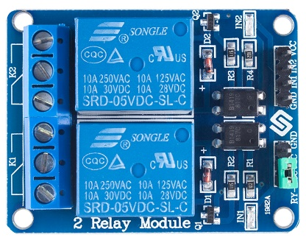
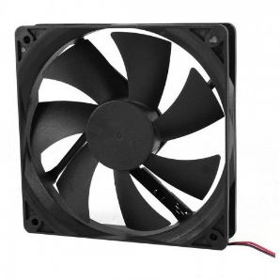
Basic Architecture
FIREBASE
DHT11 Sensor
Android App
Raspberry Pi
12V DC Fan
9V Battery
5V Relay

Slide 8
Design Approach
Application : Temperature Monitoring and Control
This project presents the design and simulation of the temperature monitoring and control based on the room temperature
A temperature sensor has been used to measure the temperature of the room and the fan is turned ON or OFF according to the room temperature
If the temperature is greater than or equal to 30 degrees Relay is ON, it uploads the sensor data to firebase and relay turns ON the fan
If the temperature is below 30 degrees Relay is OFF, it uploads the sensor data to firebase and relay turns OFF the fan

Slide 9
Design Approch
Start
Sensor
Take temperature sensor values
Connect to firebase database
If automatic
No
Yes

Slide 10
No
Temperature>=30
Yes
Switch ON Relay
Relay turns ON Fan
Switch OFF Relay
Upload temperature data
Check Relay Parameter
No
Yes
Relay turns OFF Fan
Switch OFF Relay
Switch ON Relay
Relay turns OFF Fan
Relay turns ON Fan

Slide 11
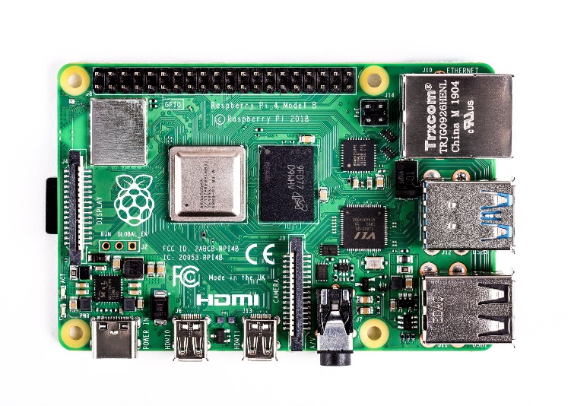
Specifications of Hardware and Software Tools
Raspberry Pi 4 Model B :
Raspberry Pi 4 Model B is the latest product in the popular Raspberry Pi range of computers. Increase in processor speed, multimedia performance memory, and connectivity compared to the prior-generation Raspberry Pi 3 Model B+, while retaining backwards compatibility and similar power consumption. For the end user, Raspberry Pi 4 Model B provides desktop performance comparable to entry-level x86 PC systems.

Slide 12
Specifications of Hardware and Software Tools
Specifications :
Processor : Broadcom BCM2711, Quad core Cortex-A72 (ARM v8) 64-bit SoC @ 1.5GHz
Memory : 2GB, 4GB or 8GB LPDDR4-3200 SDRAM (depending on model)
Connectivity : 2.4 GHz and 5.0 GHz IEEE 802.11ac wireless, Bluetooth 5.0, BLE, Gigabit Ethernet, 2 USB 3.0 ports, 2 USB 2.0 ports.
GPIO : Raspberry Pi standard 40 pin GPIO header (fully backwards compatible with previous boards)
Video and Sound : 2 × micro-HDMI ports (up to 4kp60 supported), 2-lane MIPI DSI display port, 2-lane MIPI CSI camera port, 4-pole stereo audio and composite video port
Multimedia : H.265 (4kp60 decode), H264 (1080p60 decode, 1080p30 encode), OpenGL ES 3.1, Vulkan 1.0
SD Card Support : Micro-SD card slot for loading operating system and data storage
Input Power : 5V DC via USB-C connector (minimum 3A*), 5V DC via GPIO header (minimum 3A*)
Power over Ethernet (PoE) enabled (requires separate PoE HAT)
Operating temperature : 0 – 50 degrees C ambient

Slide 13
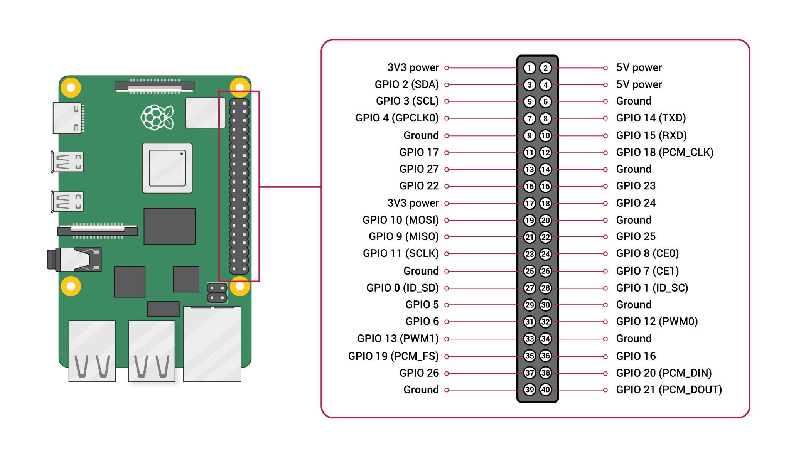
Specifications of Hardware and Software Tools
Raspberry Pi Pin Configuration

Slide 14

Specifications of Hardware and Software Tools
DHT11 Humidity & Temperature Sensor :
DHT11 Temperature & Humidity Sensor features a temperature & humidity sensor complex with a calibrated digital signal output.
By using the exclusive digital-signal-acquisition technique and temperature & humidity sensing technology, it ensures high reliability and excellent long-term stability.
Each DHT11 element is strictly calibrated in the laboratory that is extremely accurate on humidity calibration.
The single-wire serial interface makes system integration quick and easy. Its small size, low power consumption and up-to-20 meter signal transmission making it the best choice for various applications.

Slide 15
Specifications of Hardware and Software Tools
DHT11 Specifications
Operating Voltage: 3.5V to 5.5V
Operating current: 0.3mA (measuring) 60uA (standby)
Output: Serial data
Temperature Range: 0°C to 50°C
Humidity Range: 20% to 90%
Resolution: Temperature and Humidity both are 16-bit
Accuracy: ±1°C and ±1%

Slide 16
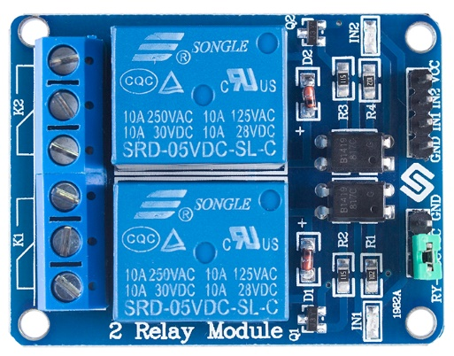
Specifications of Hardware and Software Tools
5V Relay Module:
This is a LOW Level 5V 2-channel relay interface board, and each channel needs a 15-20mA driver current. It can be used to control various appliances and equipment with large current. It is equiped with high-current relays that work under AC250V 10A or DC30V 10A. It has a standard interface that can be controlled directly by microcontroller.
Features:
Relay Maximum output: DC 30V/10A, AC 250V/10A
5V Relay Module with Optocoupler LOW Level Triger expansion board, which is compatible with Arduino and Raspberry Pi
Standard interface that can be controlled directly by microcontroller ( 8051, AVR, *PIC, DSP, ARM, ARM, MSP430, TTL logic)
Relay of high quality loose music relays SPDT. A common terminal, a normally open, one normally closed terminal
optocoupler isolation, good anti-jamming

Slide 17
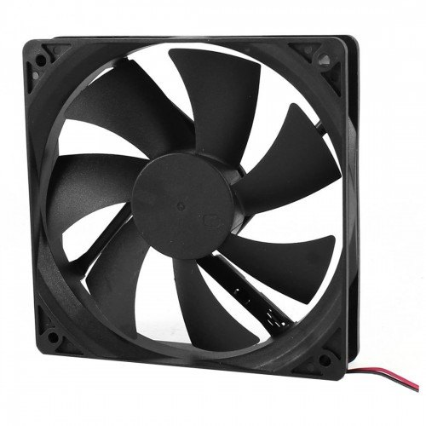
Specifications of Hardware and Software Tools
12V DC Fan :
A DC motor is any motor within a class of electrical machines whereby direct current electrical power is converted into mechanical power. Most often, this type of motor relies on forces that magnetic fields produce. Regardless of the type, DC motors have some kind of internal mechanism, which is electronic or electromechanical. In both cases, the direction of current flow in part of the motor is changed periodically. The speed of a DC motor is controlled using a variable supply voltage or by changing the strength of the current within its field windrings.
Features
Rated voltage:12V.
No-Load Speed:35000±10% RPM/MIN; No-Load Current: 0.85A.
Diameter 38.5mm.
Length 57mm.
Shaft 3.17mm.
Weight: 255g(APPROX).

Slide 18
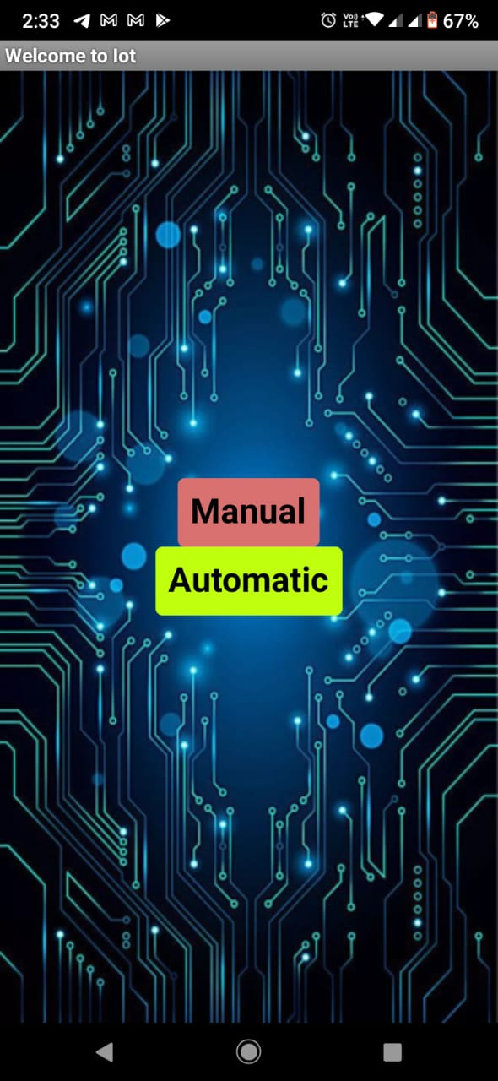
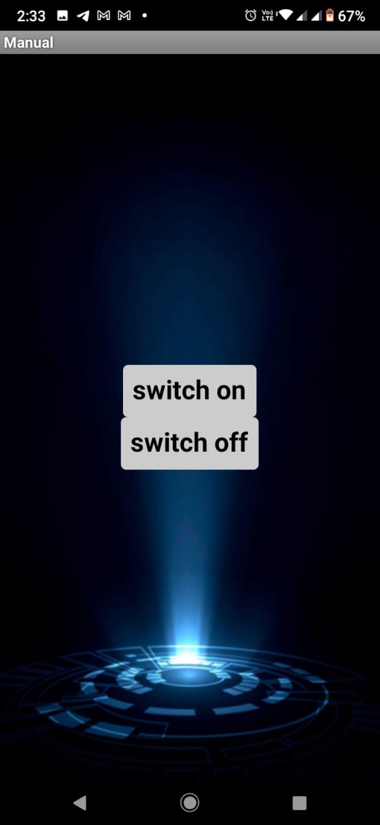
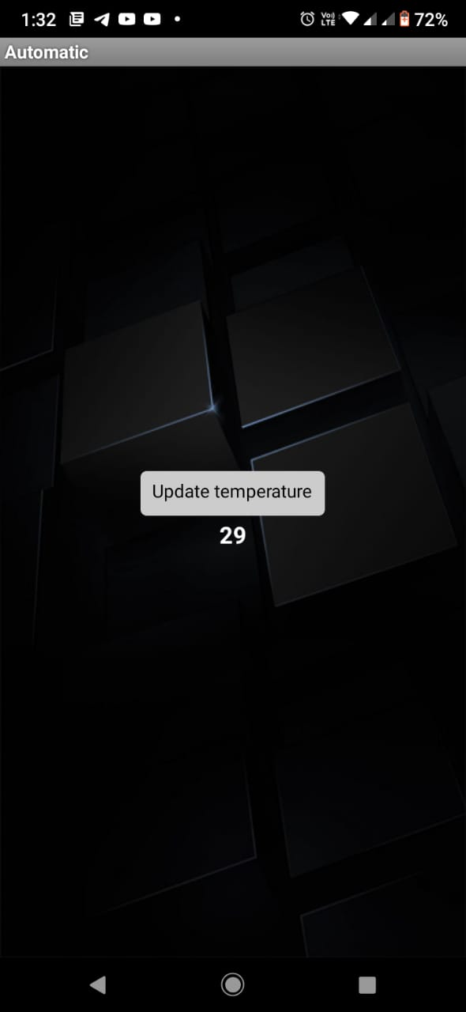
Specifications of Hardware and Software Tools
Android App :
Screen 1
Manual Screen
Automatic Screen

Slide 19
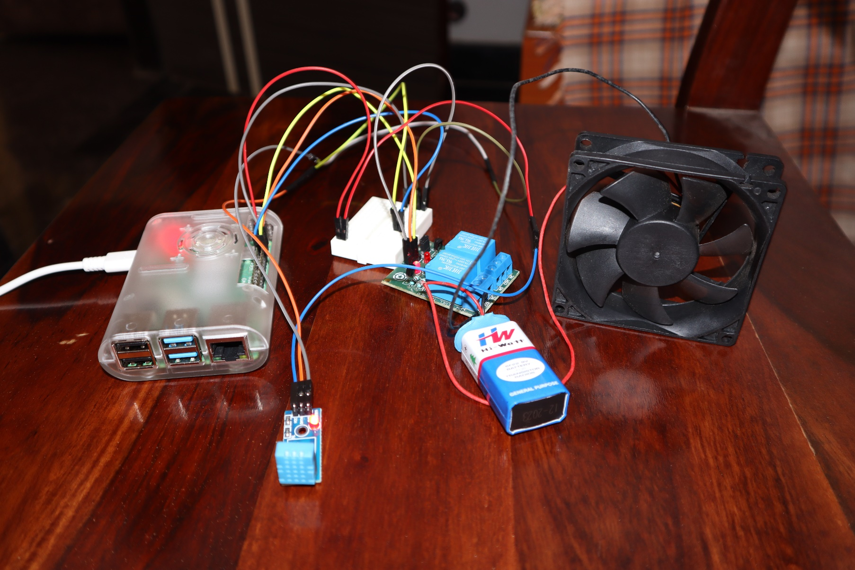
Connection Setup

Slide 20
VIDEO DEMONSTRATION

Slide 21
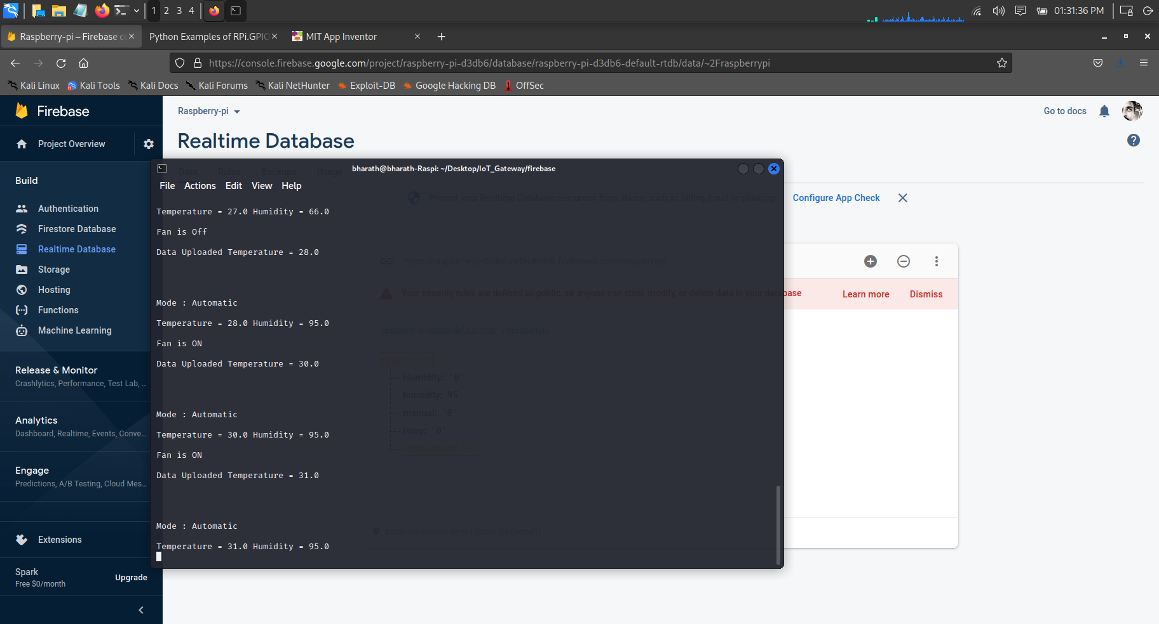
Experimental Results
Automatic Mode Result

Slide 22
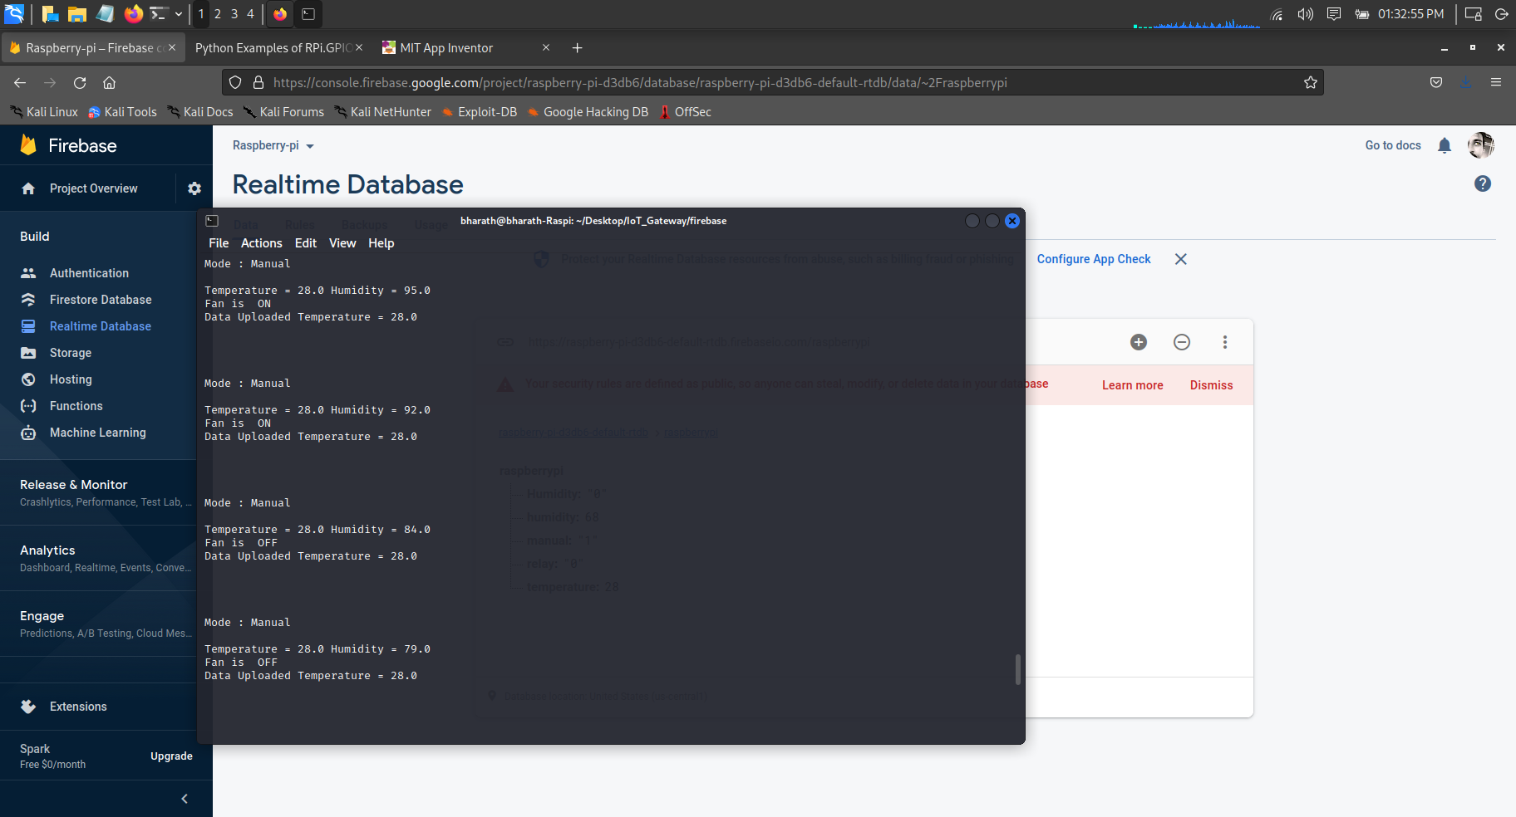
Experimental Results
Manual Mode Result

Slide 23
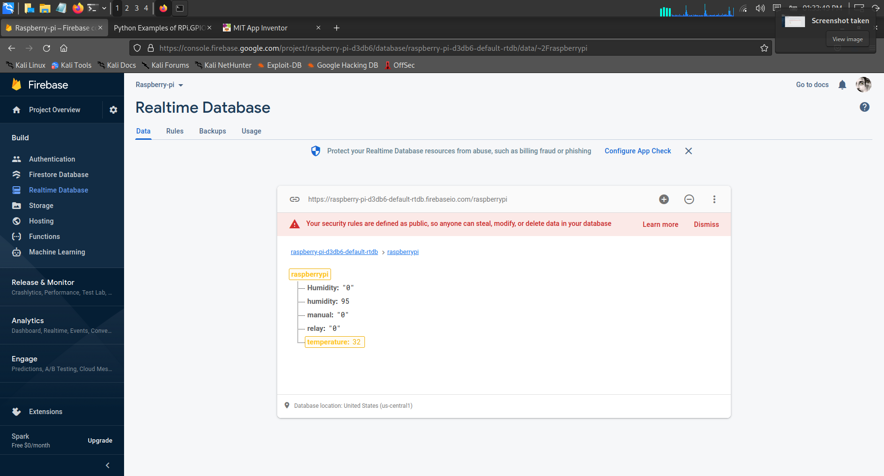
Experimental Results
Cloud Data

Slide 24
Conclusion
A simple IoT gateway is implemented for temperature monitoring and control using Raspberry Pi as IoT Gateway
The different hardware components and software designs are clearly described.
The Relay can be controlled manually or automatically through android App.
This project is also implemented to reduce power consumption.
In future more sensors and Actuators can be integrated with the Gateway and more processing can be done at the gateway level.

Slide 25
THANK YOU

